Slide 1

Sales Forecasting Using ARIMA Model
Group 2
Abhishek Ram Karuturi (AXK220223)
Geethik Kancharla (GXK220028)
Hemanth Reddy Mutra (HXR220006)
Manihaas Pasula (MXP220067)
Venkata Sai Manoj Hari (VXH220015)
Venkatesh Mamidipalli (VXM220078)
Vikas Reddy Gillella (VXG220063)
Vishnu Samhith Yerraneni (VXY220011)
Notes:
Save this document with a new name before you begin work.
When adding a new slide, click on the small arrow next to “New Slide” on the toolbar. Select the layout that will best fit the content you want to add.
Change the layout of an existing slide: click the “Layout” button on the top toolbar to reformat your existing content to another master slide.
Refer to utdallas.edu/brand for specific rules on using the University logos and wordmarks.

Slide 2
Problem Statement
What will be the Superstore’s sales performance in the upcoming months?
We aim to predict future sales trends using time series analysis. This helps us gain valuable insights into future demand patterns. This assists us in optimizing marketing strategies, Inventory management , staffing levels and operational costs in future.
Challenges and Importance:
We are interested in this question as effective sales forecasting is crucial for startup businesses to remain competitive and sustainable. With the limited data (4 years) of sales data, how to effectively forecast monthly sales for the coming years and uncover insights that lead to beter decision making and improved performance

Slide 3
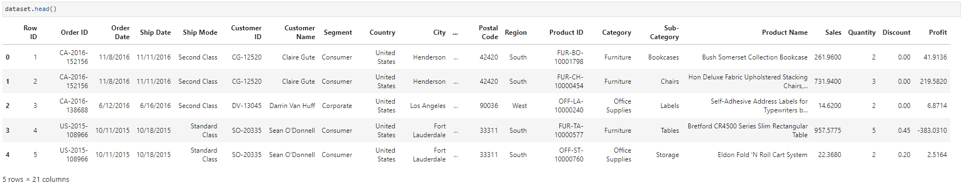
Data Set
We plan to use historical sales data from the Superstore Sales Dataset.
The dataset includes daily sales figures for each order ID, which we use in our model.

Slide 4
Approach
Our approach involves the following steps:
Data Preprocessing:
Handling outliers, converting date formats, and aggregating sales by date.
Exploratory Data Analysis (EDA):
Visualizing sales trends over time.
Checking for seasonality and stationarity.
Model Building:
Fitting the SARIMA model to the data.
Optimizing model parameters.
Forecasting:
Generating future sales predictions.

Slide 5
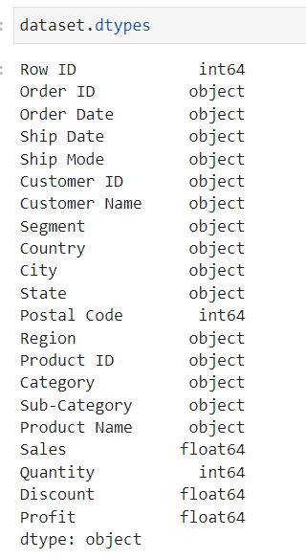
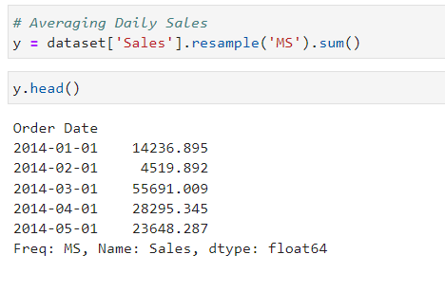
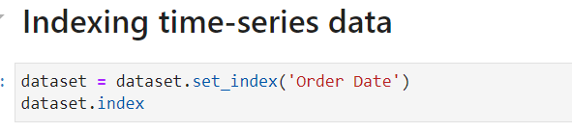
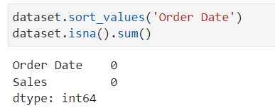
Preprocessing

Slide 6
Why Forecast Monthly Sales Data rather than daily?
Aggregated Insights: Aggregating daily sales data to monthly averages provides a higher-level summary of sales performance, which may be sufficient for strategic decision-making or long-term planning. Monthly forecasts can help identify broader trends and patterns.
Reduced Noise: Aggregating data at the monthly level can help reduce the impact of random fluctuations and noise, making it easier to identify underlying trends and seasonality.
Simplified Modeling: Forecasting at the monthly level may require simpler models compared to daily forecasting, potentially reducing computational complexity and model training time.
Evaluation: Evaluating the accuracy of monthly forecasts may be more straightforward compared to daily forecasts, as you're working with fewer data points. However, it's important to ensure that the aggregated forecasts capture the underlying dynamics of the sales data effectively.

Slide 7
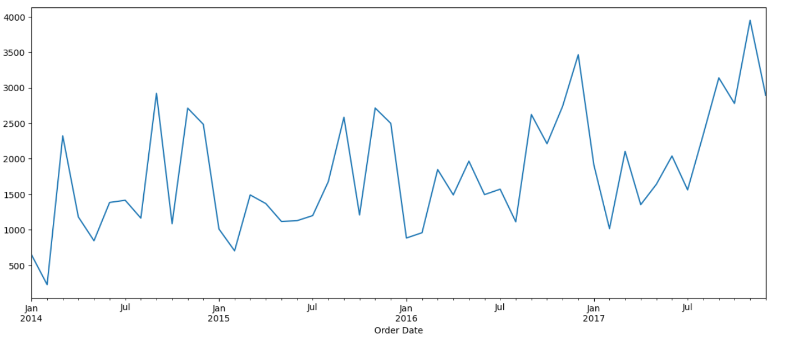
Sales Data

Slide 8

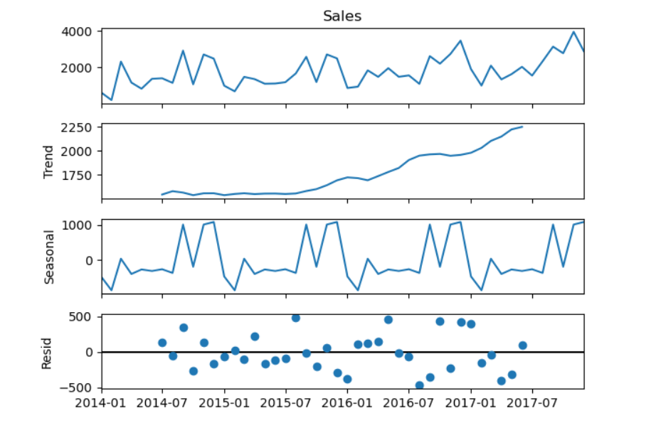

Slide 9
Model Setup
Due to the very limited data available, we do not want to use train-test split and instead used all available data for training our SARIMA model.
We depend on diagnostic measures such as residual diagnostics, AIC/BIC values, and visual inspection of forecast accuracy.

Slide 10
ARIMA
Autoregressive Integrated Moving Average Model belongs to a class of models that explains a given time series based on its own past values -i.e.- its own lags and the lagged forecast errors. The equation can be used to forecast future values. Any ‘non-seasonal’ time series that exhibits patterns and is not a random white noise can be modeled with ARIMA models.
ARIMA Models are specified by three order parameters: (p, d, q),
p is the order of the AR term
q is the order of the MA term
d is the number of differencing required to make the time series stationary
Types of ARIMA Model
ARIMA : Non-seasonal Autoregressive Integrated Moving Averages
SARIMA : Seasonal ARIMA
SARIMAX : Seasonal ARIMA with exogenous variables
If a time series, has seasonal patterns, then we need to add seasonal terms and it becomes SARIMA, short for Seasonal ARIMA.

Slide 11

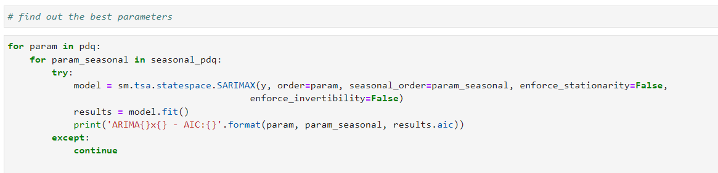
Setup for the model

Slide 12
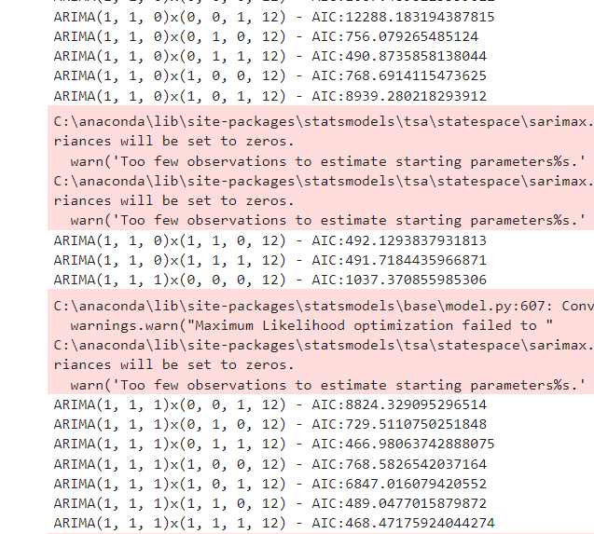
AIC stands for Akaike Information Criterion. It's a metric used to compare the relative quality of statistical models for a given dataset.
AIC is commonly used to evaluate different model specifications. When comparing SARIMA models, for example, we would typically choose the model with the lowest AIC value, as it indicates the best trade-off between model fit and complexity for your dataset.

Slide 13
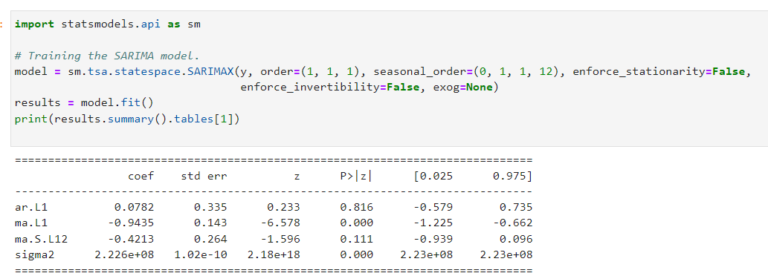
Training the SARIMA Model

Slide 14
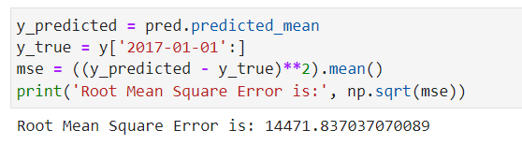
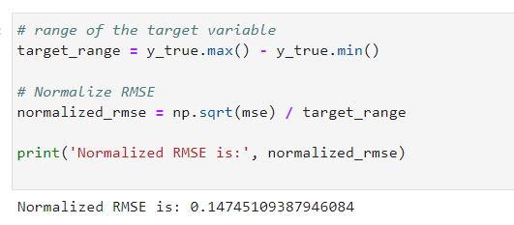
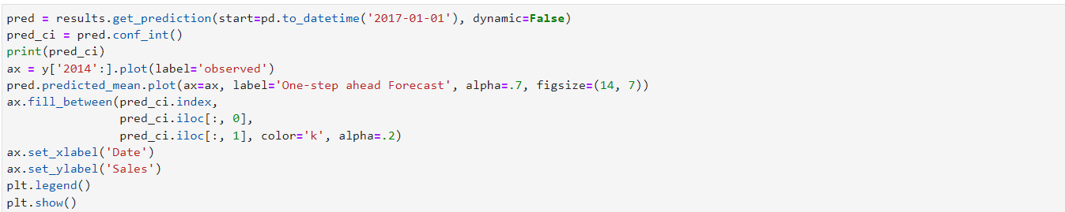
Model Evaluation
MSE
A normalized RMSE value of approximately 0.147 indicates that the root mean square error is relatively low compared to the range of the target variable
It suggests that the model is performing well in terms of predicting the target variable relative to its range
Comparing actual sales with the predicted sales from 2017/01/01 till the end of the data

Slide 15
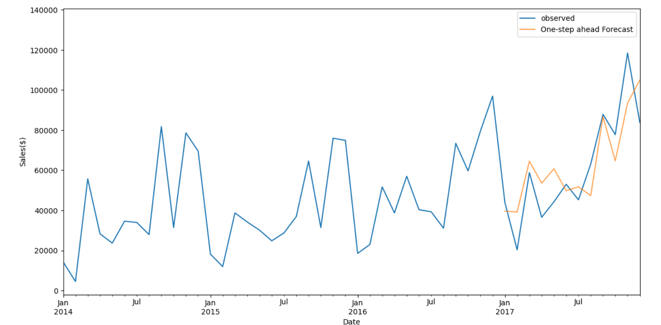

Slide 16
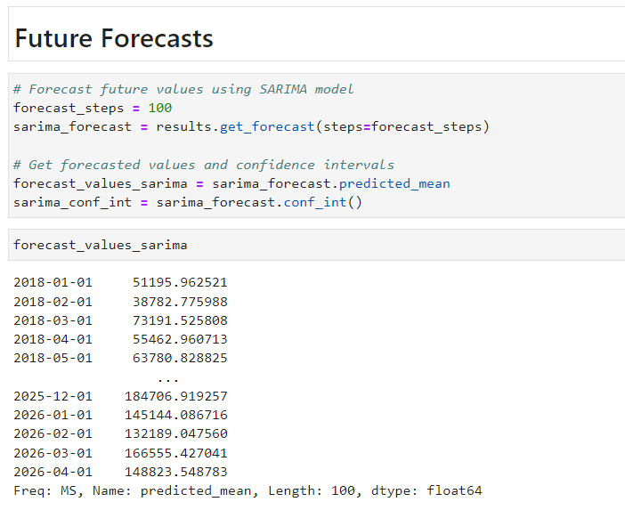
Forecasts

Slide 17
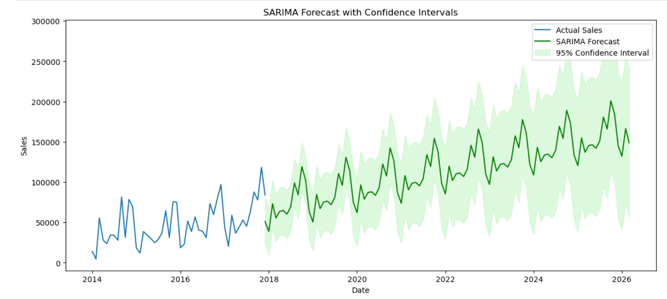

Slide 18
Scope for Future Research
Inventory management – Based on Category, Sub category and product wise forecasts.
Optimizing Staffing – Based on demand, sales and Profit forecasts
Optimizing marketing strategies

Slide 19

THANK YOU
Thank you

